Slide 1


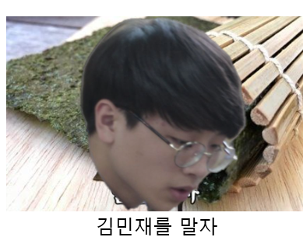

Slide 2
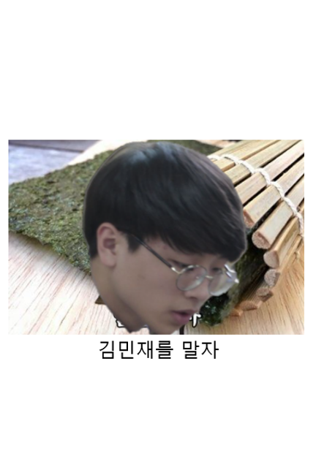
이전화면
재물운
시작하기
다시하기
연애운 - 솔로
오늘의 운세
연애운 - 커플

Slide 3










1
2
3
4
Waman’s thought
Destiny
Blossom
Man’s thought
5
6
7
8
9
Heights
Reward
Fidelity
Honours
Gifts

Slide 4










10
11
12
13
14
Peace
Departure
Revelation
Well-being
Devil
15
16
17
18
19
Fireside
Water
Motion
Breakdown
Light

Slide 5


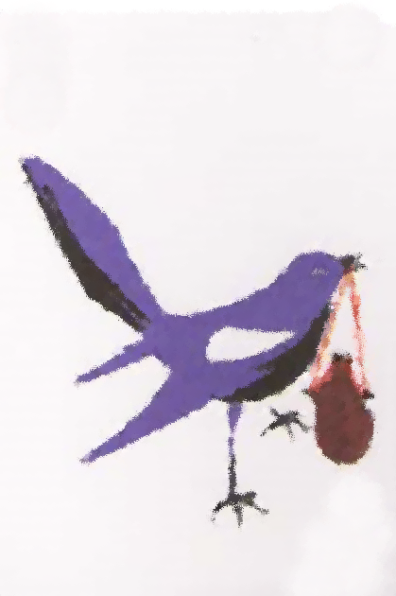



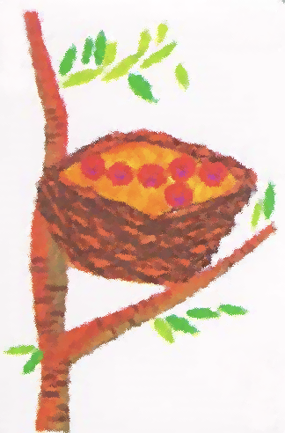

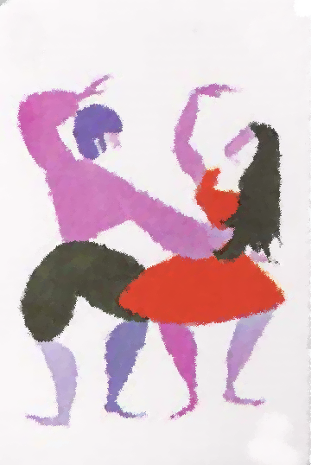

20
21
22
23
24
Prosperity
Bee
Magpie
Message
Business
28
29
25
26
27
Union
Home
Appeasement
Joy
Cupid

Slide 6





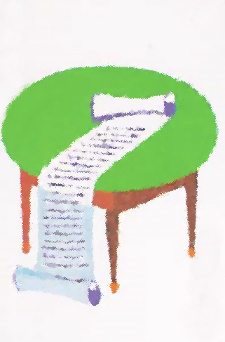




30
31
32
33
34
Weathercock
Witch
Passion
Enchained
Justice
35
36
37
38
39
Negotiation
Dragon
Danger
Zeal
Ideal

Slide 7










40
41
42
43
44
Support
Wisdom
Heritage
Chance
Celebrity
45
46
47
48
49
Felicity
Solitude
Misfortune
Protection
Death

Slide 8



50
51
52
Obstacle
Downfall
Labyrinth

Slide 9
이 카드는 어떤의미일까요?응랴랴갿갿갿갿갿갿갿갿갿ㄱ쟉ㄷ먁ㅈ댝댜ㅑㄱㄷㄷㄱ

